Slide 1
Test your
Business Viability
B. Díaz
27 de septiembre, 2019

Slide 2

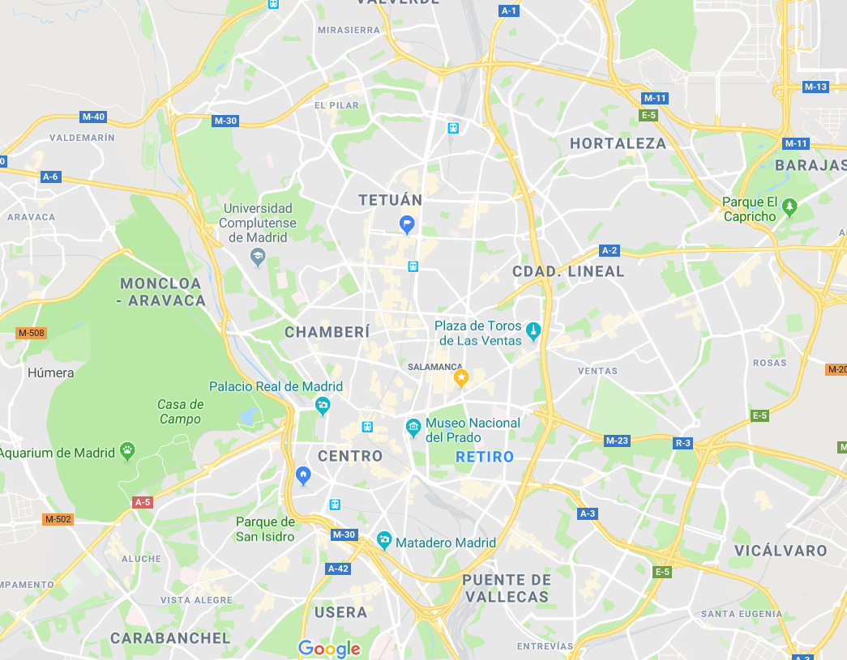

Idea
You have a great idea for a business in Madrid. But before you invest your time, capital and resources, you need to figure out whether it’s a viable business venture.
Via analytics, we will try to answer the following questions:
Descriptive questions:
understand the impact of population in a business, weekly/weekends
type of zones/business: proximity, attraction, tourism
saturation levels per business/neighborhood based on business destruction
Predictions:
Number of businesses/neighborhood expected the following year
Optimization tool:
Is a business viable for a chosen neighborhood?
What is the best neighborhood for a new business?
Icons made by https://www.flaticon.com/

Slide 3



Motivation
In my neighborhood, there are locals that have housed a different business every year, sometimes even more than two per year. I have always wondered whether people, mainly self-employees with limited resources, make a proper business viability study prior to invest in their ideas or passions.
For me it is a pity the effort and hopes that many people squander in a business that lasts less than 3 months.
Make use of Madrid public data to help entrepreneurs to decide whether to start a new business or not, and where in our city

Slide 4

Some statistics
95% of the business are microSMEs (self employees and less than 9 employees)
22,4% of the businesses are retailers with a 96% of micropymes penetration
Retailers represent the biggest businesses destruction (8 k business less YoY)
Quotes for illustration purposes only
Source: ipyme.org/Retrato de la pyme. Datos a 1 de enero de 2018

Slide 5



Main datasets
Censo de locales
Portal de datos de madrid.es:
Datos desde 2014 hasta 2018
Formato csv (fichero/año)
Id. Local
Distrito
Actividad
Estado
>5 Millones registros/año
Catastro
Portal de datos de madrid.es:
Datos desde 2013 hasta 2017
Formato csv (fichero/año)
Distrito
Tipo inmuebles
Número inmuebles
Valor catastral
24k registros/año
Padrón
Portal de datos de madrid.es (banco de datos)
Datos desde 2014 hasta 2018
Formato excel/csv
Población x distrito, barrio, edad, género, nacionalidad, educación
Gasto anual a nivel Ciudad Madrid x edad, género, educación
Turismo
Madrid.es y Inside Airbnb
Airbnb Listings (2019)
Airbnb Reviews (since 2011)
Oficinas de turismo
Tiendas con perfil turístico (xml)
Puntos de interés turístico (xml)
Tráfico / zona
TBC (NDA)
Estimación de movimientos de personas/zona/día de la semana
Anonimizada/agregada

Slide 6

Modeling Methodology
# Businesses prediction as a linear regression problem where the (independent variable) is a Time Series:
Yt = # of businesses forecast in a neighborhood
Xt = Population/neighborhood (TS)
t = 1 year
ARIMA model (box-jenkins methodology):
Check stationarity (Dickey-Fuller test)
Select p,q via ACF/PACF observation
Parameters estimation (OLS, MLE)
Model diagnosis (metrics: RMSE, MAPE, R2, residuals)
Predict

Slide 7
Project Methodology & Main Milestones
Sept. 27th
Oct. 28th
Nov. 29th
MVP
Oct. 7th
Nov. 18th
Ph. 2: Database, exploratory and descriptive phase (30h)
Prepare data in a single database
First exploratory data analysis, descriptive and main variables correlation
Ph. 0: Confirm idea (10h)
Other ideas?
Solve doubts
MVP: Results (10h)
Main insights
Conclusions
TFM documentation
Ph.1: Data gathering (10h)
Select business/neighborhood to model/target variable/variables
Download all the datasets
Ph. 3: Model and insights (iterative phase) (20h)
Prepare model: visualize the series, stationarize, modeling & hyperparameter tunning, model performance, predict
Insights
Future increments:
Optimization tool
Set saturation levels
Extend to all neighborhoods and businesses
App tool

Slide 8


Next steps
Clarify doubts:
Error: EmptyDataError: No columns to parse from file (fichero padron)
Optimization modelling/tool
Project doubts tutoring methodology
Data gathering and target variable selection (Due date: October 7th)
Look for the 5Js shop closest to my neighborhood
Follow the project in: https://github.com/bdiazcor/Kshool-TFM-/

Slide 9
Appendix

Slide 10
Main datasets
Datos.gob.es (nivel estatal)
Censo de edificios por tamaño de población: 01008c.csvFecha ¿?
Censo de edificios e inmuebles/pobalción: 1mun00sc.csv: censo de edificios e inmuebles/pobalción. Fecha ¿?
Compraventa de viviendas desde 2007 hasta 2018, por comunidad autonoma y provincia. 6155sc.csv. Interesante
Empleo total y asalariado Resultados por provincias ramas de actividad magnitud y periodo (Identificador API: /t35/p010/base2010/l0/02002.px): 02002sc.csv. Años 2012-2016. No muy claro
Nacimientos por comunidades y ciudades autónomas de residencia de la madre y mes. Movimiento Natural de la Población Resultados Provisionales (Identificador API: /t20/e301/provi/l0/01005.px):01005sc.csv. Só 2019
Censo de locales
https://datos.madrid.es/sites/v/index.jsp?vgnextoid=23160329ff639410VgnVCM2000000c205a0aRCRD&vgnextchannel=374512b9ace9f310VgnVCM100000171f5a0aRCRD-> histórico de locales desde 2014
Viviendas turísticas: Seccion: I, Division 55
Padron de madrid, edad, sexo, inmigrantes, movimientos
Datos 2018: https://www.madrid.es/portales/munimadrid/es/Inicio/El-Ayuntamiento/Estadistica/Areas-de-informacion-estadistica/Demografia-y-poblacion/Cifras-de-poblacion/Padron-Municipal-de-Habitantes-explotacion-estadistica-/?vgnextfmt=default&vgnextoid=e5613f8b73639210VgnVCM1000000b205a0aRCRD&vgnextchannel=a4eba53620e1a210VgnVCM1000000b205a0aRCRD
Histórico desde 2014: https://datos.madrid.es/sites/v/index.jsp?vgnextoid=5deb7700f69e8410VgnVCM2000000c205a0aRCRD&vgnextchannel=374512b9ace9f310VgnVCM100000171f5a0aRCRD
Banco de datos Madrid.es (si no encuentro algo): http://www-2.madrid.es/CSE6/control/menuCSE
- Gasto anual por educación, sexo, hogar, a nivel de Madrid
INE: Proyecciones de población y de hogares (hasta 2068) http://www.ine.es/dyngs/INEbase/es/categoria.htm?c=Estadistica_P&cid=1254734710984
Proyecciones de población y de hogares
Catastro - datos desde 2013
https://datos.madrid.es/portal/site/egob/menuitem.c05c1f754a33a9fbe4b2e4b284f1a5a0/?vgnextoid=3ed1854c8410b410VgnVCM2000000c205a0aRCRD&vgnextchannel=374512b9ace9f310VgnVCM100000171f5a0aRCRD&vgnextfmt=default
Turismo
Airbnb:
http://insideairbnb.com/get-the-data.html
10 July, 2019 Madrid listings.csv.gz Detailed Listings data for Madrid
10 July, 2019 Madrid calendar.csv.gz Detailed Calendar Data for listings in Madrid
10 July, 2019 Madrid reviews.csv.gz Detailed Review Data for listings in Madrid
10 July, 2019 Madrid listings.csv Summary information and metrics for listings in Madrid (good for visualisations).
10 July, 2019 Madrid reviews.csv Summary Review data and Listing ID (to facilitate time based analytics and visualisations linked to a listing).
N/A Madrid neighbourhoods.csv Neighbourhood list for geo filter. Sourced from city or open source GIS files.
N/A Madrid neighbourhoods.geojson GeoJSON file of neighbourhoods of the city.
Tiendas con perfil turistico en Madrid
https://datos.madrid.es/sites/v/index.jsp?vgnextoid=86e3a73970504510VgnVCM2000001f4a900aRCRD&vgnextchannel=374512b9ace9f310VgnVCM100000171f5a0aRCRD
https://www.esmadrid.com/opendata/tiendas_v1_es.xml
Oficinas de turismo:
https://datos.madrid.es/sites/v/index.jsp?vgnextoid=7240e6bffbfe5410VgnVCM1000000b205a0aRCRD&vgnextchannel=374512b9ace9f310VgnVCM100000171f5a0aRCRD

Slide 11
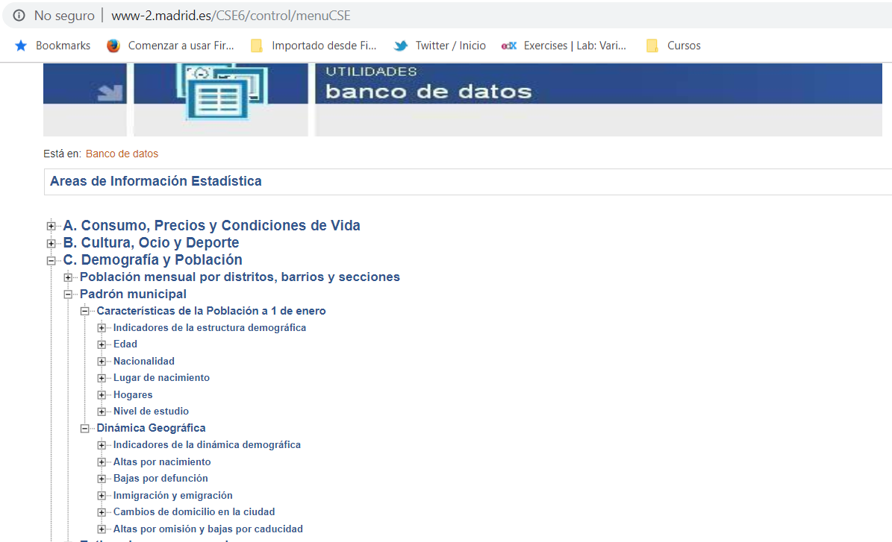
Detail Data bank (for municipal register)

